Slide 1
Modelling Approach
November 2021

Slide 2
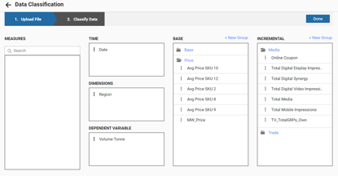
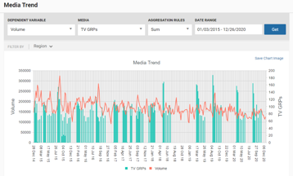
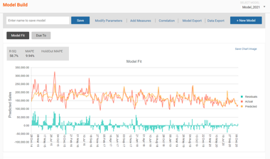
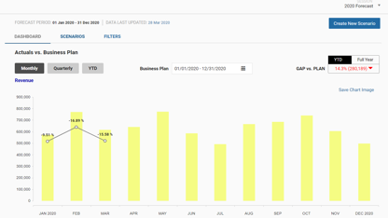
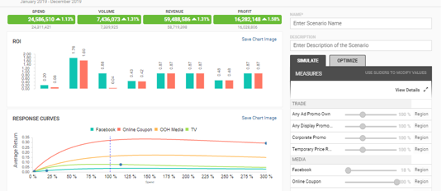
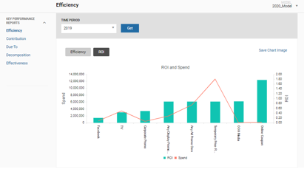
MMM SaaS Solution
Demand Drivers Platform Modules and Workflow
Apply learning, update analysis
DATA INPUT
DATA REVIEW
MODELLING
1
2
3
Manual data load & alteration via UI. Supplements automated ETL for new/ad hoc data
Assure complete & correct Modelling inputs with visual review tools
Build, test, save & modify MMM models without writing code
Review & report
`
PLANNING
SIMULATION
REPORTING
6
5
4
Generate forecast, track forecast vs actuals over time, variance analysis
What-if scenarios & marketing plan optimization
Standardized reports like Contributions, Due-To, Effectiveness & ROI

Slide 3






MMM SaaS Solution – Modelling Approach
1
2
Understand Business Questions
Data Review
Mental Models
Transformation of Independent Variables
Model Set-up
Priors based modelling
Statistical & Face Validity
Deploy models to support Business Planning Routines
Business Objective
Understanding, Aggregation and cleaning
3
Analytical Model Design
Modelling Approach
4
Analytical Model Build
5
6
Evaluate Model
Model Deployment

Slide 4
MMM SaaS Solution
Model Forms
Choice of model form depends on
Mental model of how activities affect KPI in the specific category
Nature of business questions to be addressed
Data availability
Estimation technique to be employed
Options to develop pooled regression & mixed effects model
Additive
$$Sales=Intercept+β_{Disp}ACV_{Disp}+β_{Feat}ACV_{Feat}+β_{Disc}Disc+β_{TV}TV+...$$
Multiplicative
$$Sales=Intercept⋅e^{β_{Disp}ACV_{Disp}}⋅e^{β_{Feat}ACV_{Feat}}⋅Price^{β_{Price}}⋅e^{β_{TV}TV}⋅...$$

Slide 5
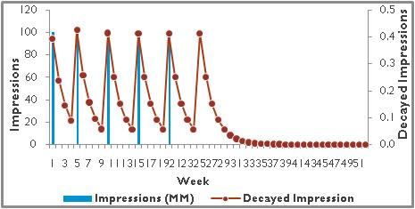
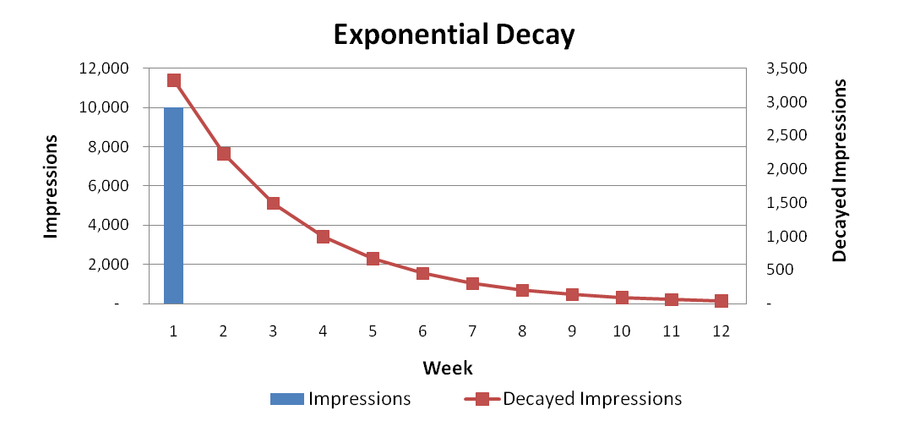
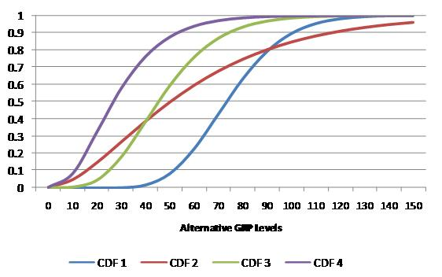
MMM SaaS Solution
Measure Transformations
Exponential Decay (Delta Transformation): Classic negative exponential decay
Ad-Stock: Incorporates decay parameter to capture carryover effects
Ad-Bank: Gamma transformation. Incorporates threshold and growth parameter to capture S-shape or Concave shape effects
Log – Log of a specific measure
Lag – lag of a measure by n number of periods
Moving Average – Average based on number of periods
Weighted Average – Weighted average with response as weight
Best practice transformations have already been implemented on DDE. Other preferred custom transformations can be added to the platform, as needed.

Slide 6
MMM SaaS Solution
Shrinkage Models
We recommend imposing a structure on the coefficient set to reduce number of independently estimated coefficients:
Pooling coefficients: Coefficients are the same across subsets of SKU/Channel combinations. Pooling coefficients assumes similar variance structures with a constant deviation from the average (varying intercept)
Shrinking coefficients: Coefficients to be similar (following a distribution as defined by the variance – covariance matrix) across subsets of SKU/Channel combinations (varying intercept and varying slope)
Most organizations have access to prior information that was distilled from other sources and should be incorporated into demand models. Bayesian Estimation techniques helps incorporate this information
Analytic Edge recommends using weighted priors derived by weighting past estimates and estimates from new data. These weighted priors must be within the distribution/standard deviation of the fixed effects estimates from the new data
Data
Prior Weight
Prior
Best Fit
Most Plausible
Regression-based and Quadratic
Programming estimation techniques

Slide 7



MMM SaaS Solution
Bayesian Priors
Historical results
Model Forms, transformations and coefficients
Decomposition and Due-To’s
Previous insights power point presentation
Detailed preferred over executive presentation
Business Discussions
Few discussions with the business leads to understand the expectations around
Contribution / ROI
Price and other execution elasticities
Macro variables elasticities

Slide 8
MMM SaaS Solution
Bayesian Priors
Historical results
Model Forms, transformations and coefficients
Decomposition and Due-To’s
Previous insights power point presentation
Lift studies
Detailed preferred over executive presentation
Business Discussions
Implications on business strategy
Contribution / ROI
Price and other execution elasticities
Macro variables elasticities

Slide 9
MMM SaaS Solution
Model Validation
FACE VALIDITY CRITERION
Data transformations based on mental models and adhering to global best practices
Correct signs on coefficients
Elasticities or volume response rates within reasonable ranges
Interactions and competitive effects within reasonable ranges
Contributions within reasonable ranges
Change to year ago due to errors of reasonable size
Change to year ago due to effect sizes sensible
Minimal use of dummy variables and trend terms
STATISTICAL VALIDITY CRITERION
Low MAPES
<10% for weekly data
High R2
>80%
Also depends on data, category and market
Small Correction Factor
To avoid under/over fitting
Alignment of predicted to actual, no odd jumps or “0”s in predicted volume
High confidence in coefficients either via reliance on Priors (holdout validation) or via high t-stat
Forecast accuracy

Slide 10
Thank you

